Slide 1
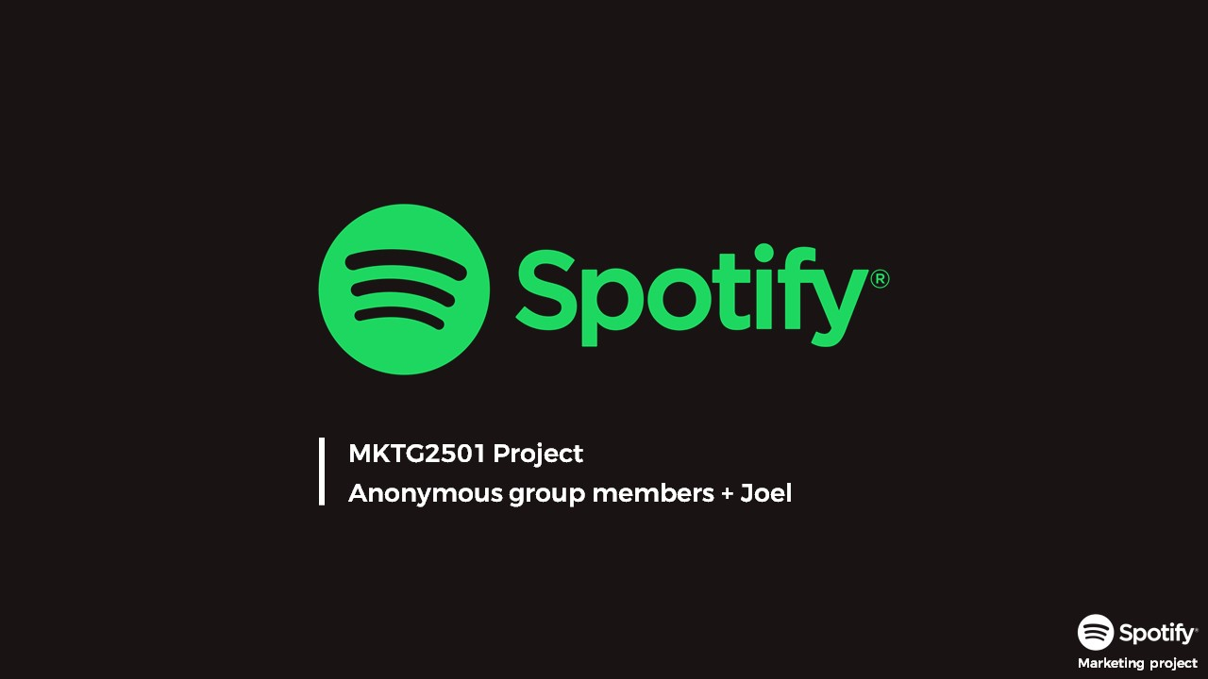


Notes:
Good evening everyone, thank you for your time.
I am Shantanu, a Product Manager at Spotify. Today I’m going to be talking about a new feature in Spotify that has the potential to gratify our users and help grow our product

Slide 2
Where do we stand?
Notes:
Now, before I spill any beans, I wanted to paint a picture that highlights our position with respect to the competition in the music streaming industry.

Slide 3
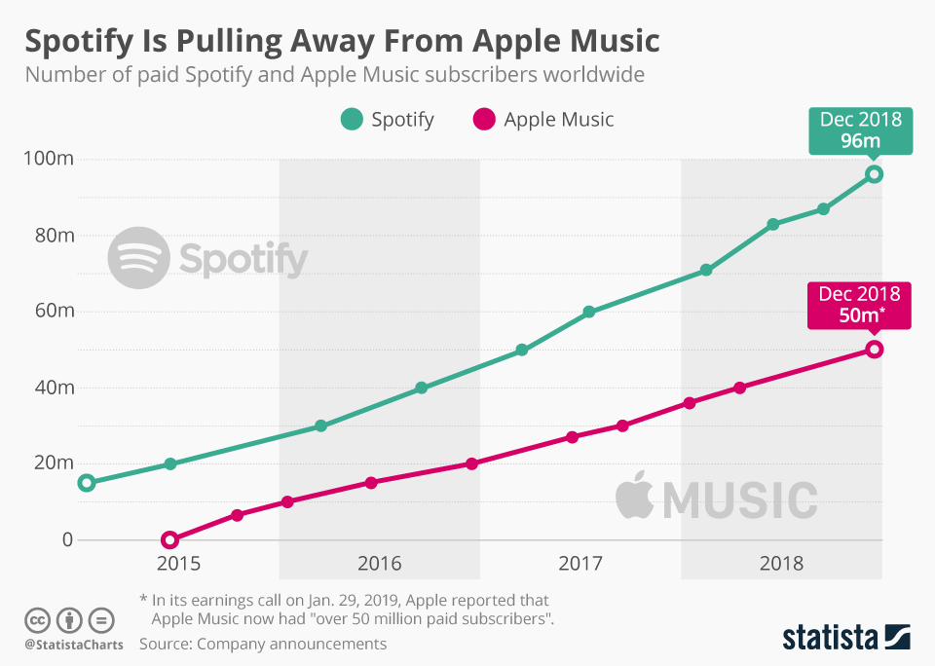
Notes:
Here’s a chart that shows where Spotify stands compared to Apple Music –it’s biggest competitor as of December 2018.
Spotify clearly is the leading music streaming service provider around the world with almost double the number of paid customers compared to Apple Music. If you look closely, you’ll also notice that the gap between the two has been increasing over the last couple of years which is a testimony to how much our users love our product compared to the competition.

Slide 4
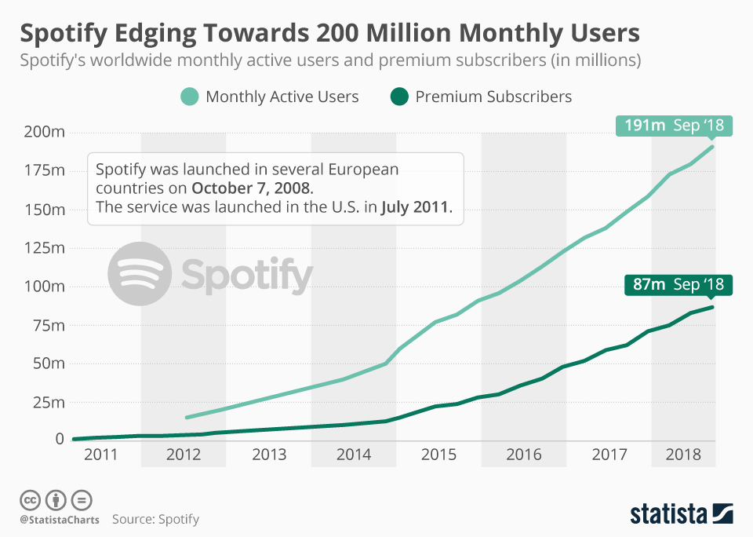
Notes:
Here’s another chart that shows how both our Premium and non-Premium subscriber numbers are growing rapidly.
Close to 200 million monthly active users, isn’t that awesome!?
This only tells us that our product is doing a tremendous job at attracting music streamers around the world!

Slide 5
What can we do to stay ahead?
Notes:
But, we don’t want to rest on these laurels do we? How do we stay ahead in this highly competitive industry?

Slide 6
Circles
Notes:
Presenting to you – Spotify Circles. A new feature in Spotify that is going to gratify our users as they stream music with their friends on Spotify.

Slide 7
What?
Notes:
So, what is this feature after all?

Slide 8
“Music is a way to dream together and go to another dimension.” – Cecilia Bartoli
Notes:
I wanted to mention a quote from Cecilia Bartoli that really resonates with me. For those of you who don’t know her, she’s a popular Grammy award winning Opera Singer.
Cecilia says -- . The reason I like the quote so much is because I believe that, in the current divisive state of the world, MUSIC can bring people together

Slide 9

Ease
Stream from multiple devices together
Together
Mood
Play your favorite songs from your own device
Dynamically created content based on mood and preferences
Notes:
Spotify Circles is a new feature that aims to remove the hassle that users feel while using the platform to listen to music in a social context.
With Spotify Circles, users will be able to stream music from the comfort of their own personal devices to a single audio output device.
Users will be able to easily pick songs from their personal Spotify libraries and queue them for playback on the audio output device at the click of a button.
Spotify Circles will also have a feature to allow users to set a mood to the listening session. Spotify will then pick songs that match that mood/genre while also accommodating for the personal preferences of all the users involved in the Circle.

Slide 10
Why?
Notes:
So, you might ask, why is this feature relevant?

Slide 11
Personas
Notes:
To answer that question, let’s first meet our target personas

Slide 12
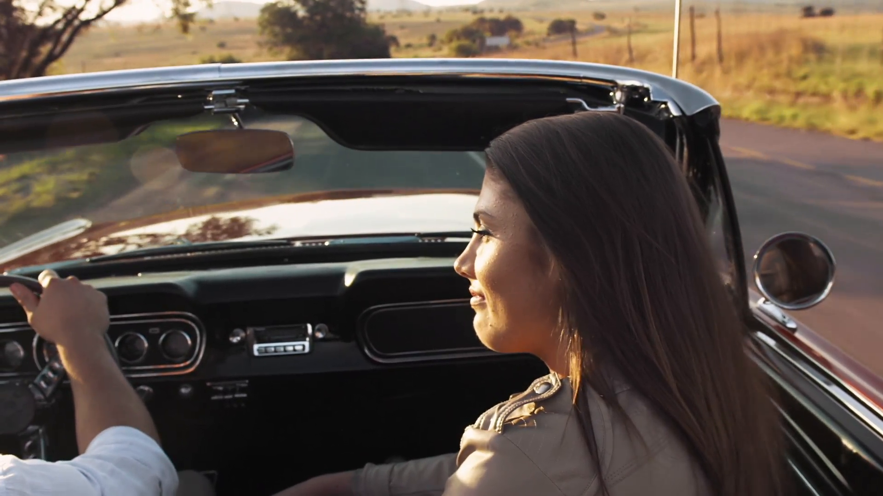
“I always find myself in the passenger seat of my friend’s car asking him for his phone so that I can find that one song I just found the last week and play it from his phone .”
Socially active
Listens to music in the car and at parties with her friends
Hates looking up her favorite songs on her friend’s phone so that she can play them in the car.
Cathy, 23 | Student | Seattle, WA
Notes:
Meet Cathy, a socially active student living in the Seattle area.
Cathy is a Spotify customer who uses the platform to stream music while she’s in a car. Cathy loves the outdoors and frequently goes on short road trips with her friends over the weekends.
Since Cathy is not particularly fond of driving, it’s her friends who usually drive them to the place they are headed.
Cathy complains about always finding herself in the passenger’s seat asking her friend for his phone so that she can find songs she recently discovered on Spotify and play it for them.
Cathy feels it would be so much easier if she could play a few songs from her music library without having to go through the hassle of either pairing her phone with her friend’s car or having to look up those songs on her friend’s phone.

Slide 13

“I love throwing house parties and I want all of my guests to have a great time.”
Meets up with her friends regularly at house get-togethers.
Really busy with school – doesn’t have time to find the latest music.
Wants an easy way to find music that her friends like.
Wants to play songs based on the mood of the party.
Gwen, 26 | Student | Portland, OR
Notes:
Our second persona is Gwen, a student in Portland Oregon.
Gwen has always liked having her friends over for small get-togethers over the weekends where they all play board games and listen to music.
Gwen is usually pretty busy at school over the week and doesn’t have the time to discover new music.
Being a great host, Gwen wants all her guests to have a wonderful time and she wishes she could easily find songs that her friend’s like so that she can play them on Spotify when they’re visiting. Gwen also wants to play songs based on the mood of the party without having to do all the manual curation of music herself.

Slide 14
Why is this important?
Notes:
So, how did we validate that Spotify Circles is the next big thing for Spotify?

Slide 15
User interviews tell us
Notes:
We conducted some user interviews that validated our opportunity hypothesis.
About 70% of users mentioned that they listened to music at home and a whopping 90% of users said that they listen to music in their car.

Slide 16
Notes:
Users were asked on how they usually share music with others.
A significant 60% of them mentioned that they usually share Spotify links with other users over social media platforms but the other 40% did mention that they instead prefer to play the new songs they found while they’re with their friends and relatives.
When asked about whether they found something missing in Spotify,
<Consider removing>30% of the users mentioned that the song recommendations that Spotify gives could be better. Another 20% said that Spotify was missing some content that they wanted and another 20% would have liked to have lyrics for more songs within the platform itself.
Interestingly, 30% of the users complained about not being able to queue songs in Spotify even though they weren’t asked about it!

Slide 17
Usage pattern and complaints indicate a desire for a better social listening experience
Notes:
Looking at these stats, we can conclude that users like to share music by playing their discoveries when they’re with others.
The user feedback also tells us that users aren’t satisfied with the group music listening experience that they currently have while using Spotify and would like the ability to queue songs to a single audio output device.

Slide 18
What’s the MVP?
Notes:
So, what will our minimum viable product be?

Slide 19
iOS
Proximity based notification to start Circle
Queue songs from multiple devices
View friends in Circle and add new ones
View all Circles from the past
Notes:
The MVP will be built for the iOS platform considering a vast majority of our users stream music from Apple devices.
The set of features includes –
Users will get proximity-based notifications to start a Circle. Spotify will be able to sense whether two users who are friends on Spotify are close to each other and recommend starting a Circle by sending a push notification.
Users will have the ability to queue songs from their own personal devices by browsing their Spotify libraries.
Users will be able to see the list of their friends that our part of the current Circle and also add new ones.
Finally, users will be able to view the Circles that they were a part of. This is so that they can easily go back and find those great tunes that their friends had played the last time they were hanging out together.

Slide 20
Success Metrics
Engagement
Referral
Notes:
To understand the performance of Spotify Circles after rollout, we’ll use a combination of success metrics –
The metric that matters most for us is user engagement.
We will be looking at the number of users who are using Spotify Circles.
Another metric that we will be evaluating is the number of referrals that get sent out by Spotify users to non-Spotify members with the launch of this feature. We expect this value to increase as users are likely to invite others to the platform when they listen to music with them using Spotify Circles.

Slide 21
How does it work?
Notes:
Let’s take a tour of what Spotify Circles will look like through some mockups

Slide 22

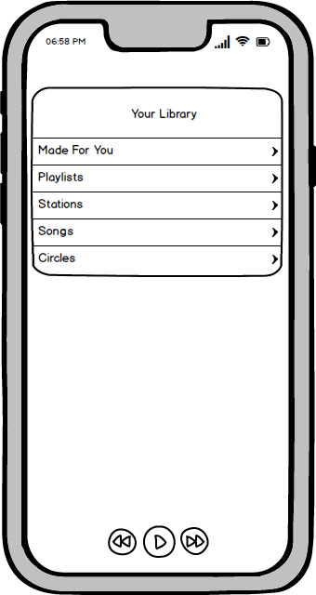


Notes:
We’ll be using an iPhone as an example for these mockups.
As Spotify senses that a user is in the vicinity of another Spotify user who’s their friend, a notification will be sent out recommending them to start a Circle and listen to music together.
When the user taps on the notification, they’ll be taken into the Spotify application on their phone.
The Spotify application’s home page currently looks like this. In addition to the options that currently exist on this page, users will see a new option called ‘Circles’.
When the users tap on ‘Circles’ they will be taken to a page where they will see a bunch of options in relation to Circles.

Slide 23
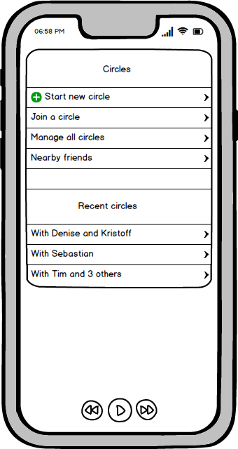
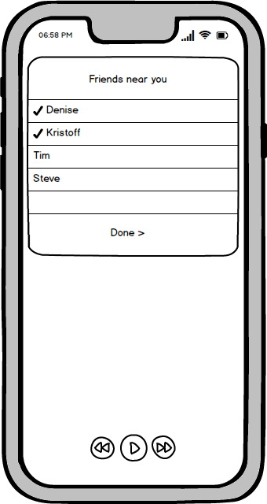
Notes:
On the Circles page, users will have the option to-
Start a circle,
Join an existing circle,
Manage all their circles,
And see their Spotify friends nearby
Users will also be shown their recent spotify circles in case they wish to view the songs that were played in those circles.
When the users tap on the start a new circle button, they will be directed to a new page where they’ll first be shown of their Spotify friends nearby so that they can add them to the Circle. After selecting their friends, users will click on the Done button.

Slide 24
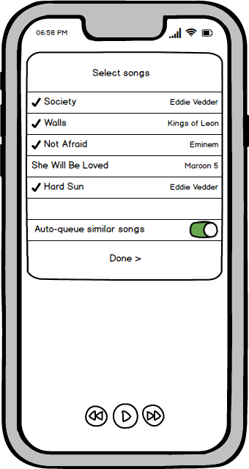
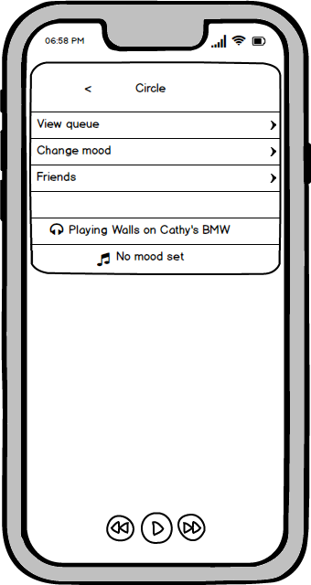
Notes:
Once the users click on ‘Done’, they’ll be taken to this page where they will be able to see a list of songs that they have played recently.
Users can select which songs they would like to add to the Circle.
Users will also notice an ‘Auto-queue similar songs’ switch below the song list. This option tells Spotify whether it should queue songs similar to the ones queued in the Circle once the original queue has been run through.
Once users are satisfied with their selection, they can click on the Done button which will direct them to the Circle information page. At this point, the music that has been queued on the Circle will start pla
On this page users will have the option to view the songs in the queue, see which friends are in the queue and also have the option to set a Mood for the Circle.
If the users wish to choose a Mood for the circle, they will tap on the ‘Change mood’ button and be directed to the Moods page

Slide 25
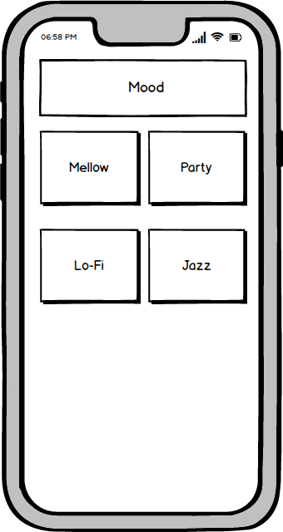
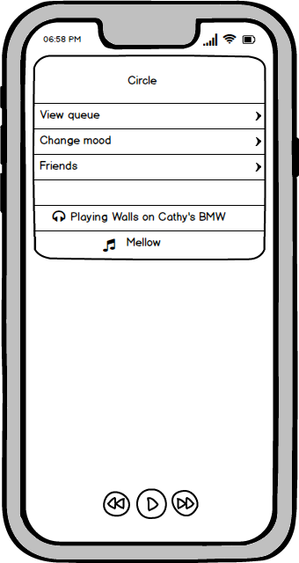
Notes:
On the Moods page, the users will see a list of different moods or genres that they can choose from. This list will be based on the preferences of users in the Circle.
To select a mood, the user will tap on the respective mood button. Once they do that, they will be directed to the Circle information page again and Spotify will start playing songs tailored to that mood while also accommodating for the tastes of users in the Circle.
The UI will also indicate that a mood has been set for the Circle which in this example you can see is the ‘Mellow’ mood.

Slide 26
What about the launch?
Notes:
Now that we’ve covered what Spotify Circles looks like, let’s talk about how we’re going to launch it!

Slide 27
Pre-launch
Initial internal testing
Beta for students
Advertisements
Social Media
Notes:
Before the launch, we’ll be performing some initial testing of Spotify Circles internally within the company to get some valuable early feedback. This internal rollout will help us discover bugs. We’ll also be using surveys and user interviews to understand how we can make the feature butter.
After testing the product internally, we’ll rollout a beta version of this feature to a small set of customers. We’ll initially be targeting students as they are our biggest user base and they are most likely to listen to music in a social context.
We’ll also be showcasing some advertisements for Spotify Circles within the application and on social media such as Facebook, Twitter, Instagram and YouTube. Non-premium members will be presented both audio and visual advertisements when they are using Spotify in order to encourage them to use Circles. Premium members will see UI boards within the application linking them to Spotify Circles

Slide 28
Launch
Press Release
Partners
Notes:
Spotify Circles will be launched through a press release on the company’s website on September 3 this year. We’re targeting the start of the school year for the launch to ensure we capture our target market (which is young students).
We’ll also be partnering with Google for this launch. Google Maps currently has Spotify integration and as part of this launch, we’ll leverage that partnership to suggest users to try Spotify Circles when they are using Google Maps to get driving directions.

Slide 29
Post-Launch
Media coverage
Analyze feedback
Analyze metrics
Notes:
After launching Spotify Circles, we expect some media coverage from tech bloggers around the world. This coverage will help us analyze areas for improvement.
we’ll also be analyzing our target metrics to understand how users are engaging with Spotify Circles. We’ll also be analyzing feedback posted by users on several channels such as UserVoice and on the company’s social forums. We want to incorporate the top feedback received from our users along with fix reported bugs as soon as possible in future releases.

Slide 30
Spotify Circles will delight our users and help grow our business
Notes:
To summarize, I believe that Spotify Circles is going to delight our customers by providing a feature-set that isn’t broadly available from the competition. This will in turn help grow our business and ensure that we continue to stay ahead of our competition and make great strides in the music streaming industry.

Slide 31
Thank you
Notes:
Thank you for your time ladies and gentlemen!

